Slide 1

BIOINFORMATICS
Classification of histological microscopy images coming from pleural tissue biopsies
using pre-trained CNN and bag of features
Authors:
Luca Boretto, 244218
Raheleh Salehi, 226014

Slide 2
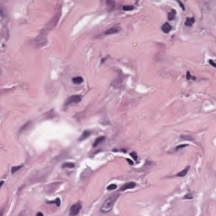
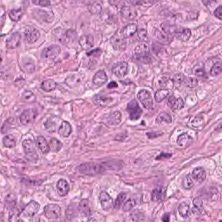
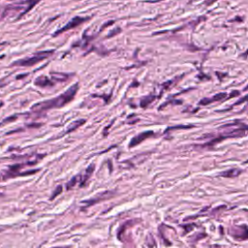
DATASET
Benign Fibrosis (F)
Mesothelioma Epithelioid (ME)
Mesothelioma Sarcomatoide (MS)
Category | # Training images | # Test images
F | 108 | 30
ME | 108 | 30
MS | 108 | 30
F
ME
MS

Slide 3
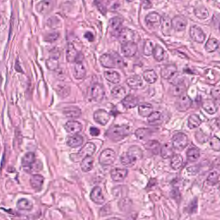
MESOTHELIOMA EPITHELIOID
60-70 % of mesotheliomas.
Wide range of morphologic patterns:
tubulopapillary
adenomatoid (microglandular)
sheet-like.

Slide 4
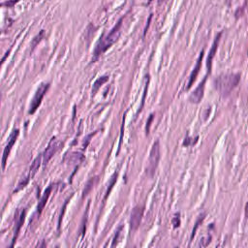
MESOTHELIOMA SARCOMATOIDE
10-20 % of mesotheliomas
Consists of:
Spindle cells arranged in fascicles or having a haphazard distribution

Slide 5
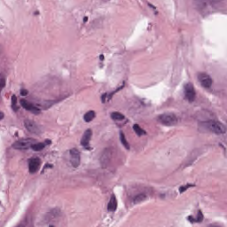
BENIGN FIBROSIS
78-88 % of non-mesothelioma tumors of the pleura.
Patternless architecture

Slide 6
WORKFLOW
RGB
DataSet
FEATURES EXTRACTION:
PRE-TRAINED CNN
DIMENSIONALITY REDUCTION:
t-SNE, PCA, LDA, NNMF
IMAGES
PRE-PROCESSING:
Additional DATASETS CREATION
CROP of the images
CLASSIFICATION:
SVM, Random Forest, Naive Bayes, k-NN
FEATURES EXTRACTION: BAG OF FEATURES
COMPARING RESULTS
CLASSIFICATION: SVM

Slide 7
IMAGES PRE-PROCESSING
RGB
3D GrayScale
Hematoxylin
Reinhard
Stain
Normalization
Using EditDataSet.m. It uses WARWICK’s Stain Normalisation Toolbox for MATLAB.

Slide 8

DEMO EditDataSet.m

Slide 9
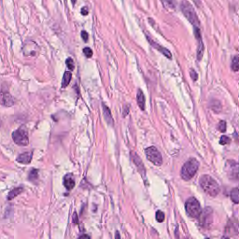
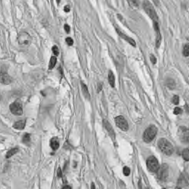
3D GRAYSCALE
RGB
3D GRAYSCALE

Slide 10

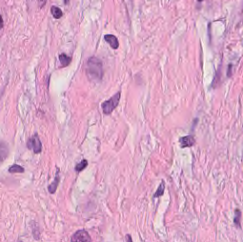
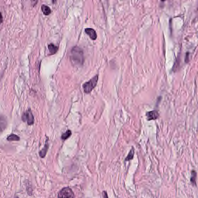
REINHARD STAIN NORMALIZATION
Target image
Source image
Output image

Slide 11
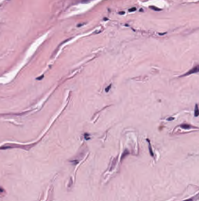
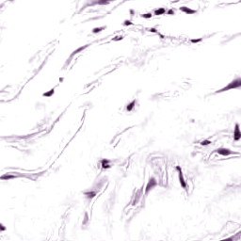
HEMATOXYLIN
Estimate the stain 3x3 separation matrix M → STAIN COLOUR DESCRIPTOR
DECONVOLVE THE IMAGE → using M to obtain the stains.
Convert the FIRST STAIN CHANNEL C(:,1) TO A COLOR IMAGE
Input image
Output image

Slide 12
WORKFLOW
RGB
DataSet
FEATURES EXTRACTION:
PRE-TRAINED CNN
DIMENSIONALITY REDUCTION:
t-SNE, PCA, LDA, NNMF
IMAGES
PRE-PROCESSING:
Additional DATASETS CREATION
CROP of the images
CLASSIFICATION:
SVM, Random Forest, Naive Bayes, k-NN
FEATURES EXTRACTION: BAG OF FEATURES
COMPARING RESULTS
CLASSIFICATION: SVM

Slide 13

FEATURES EXTRACTION using CNN
PRE-TRAINED MODES:
AlexNet
GoogLeNet
VGG-16
Inception-v3
FRAMEWORKS:
Caffe
Keras backend
Tensorflow
Weights from ImageNet
Using FeaturesExtraction_GUI.py.

Slide 14
DEMO FeaturesExtraction_GUI.py

Slide 15
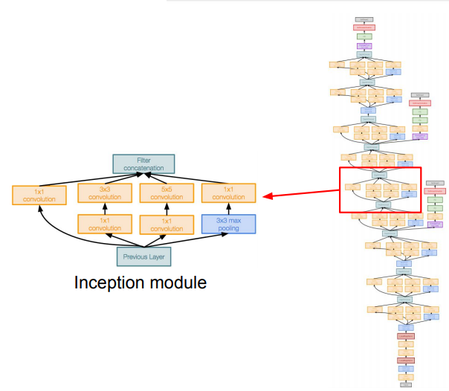
GoogLeNet
22 layers
Images are
cropped to this
dimension
Input:
224x224x3

Slide 16
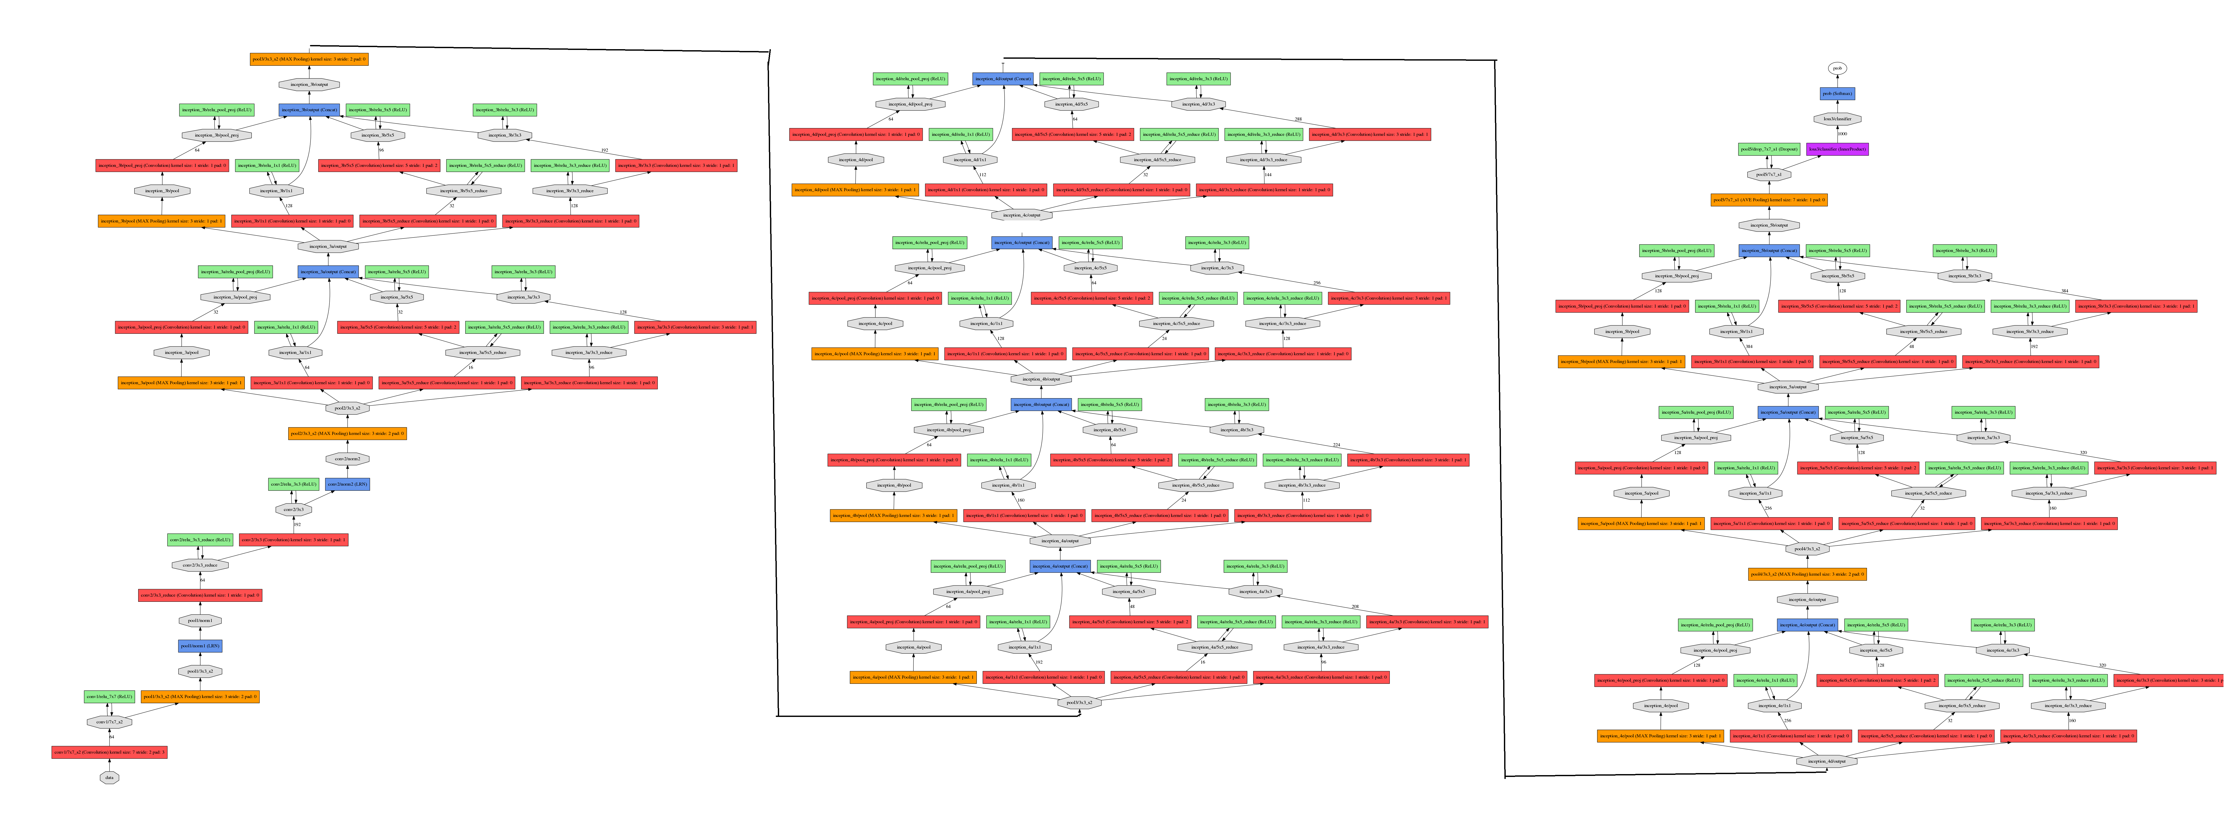


Slide 17

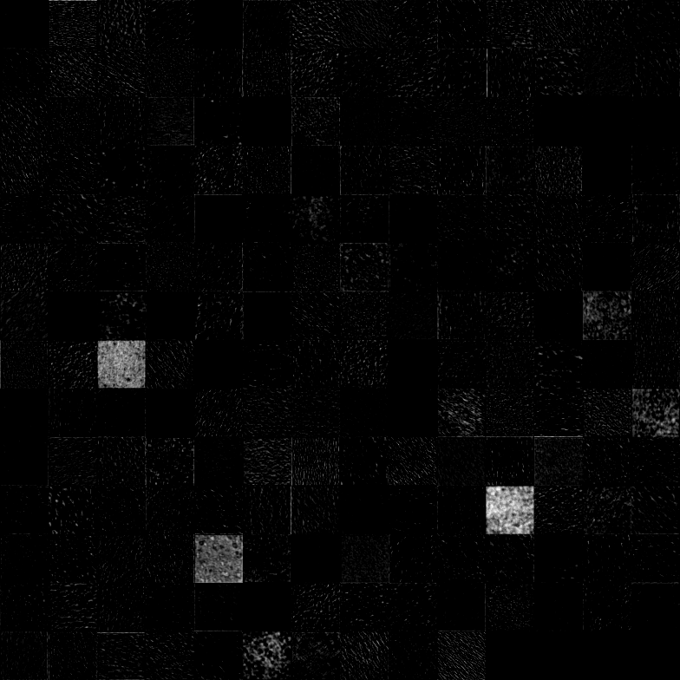
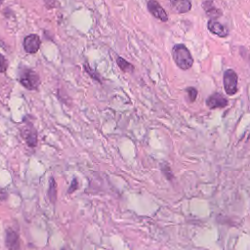
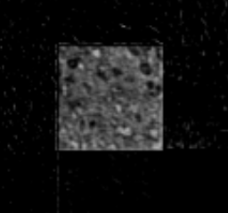
VISUALIZING ACTIVATIONS
Inception_4a_output
[14x14x512]
INPUT [224x224x3]
CONV2/3x3 [56x56x192]

Slide 18
Inception-v3
GoogLeNet
Inception-v1
Inception-v2
Inception-v3
Images are
resized to this
dimension
Input:
299x299x3

Slide 19
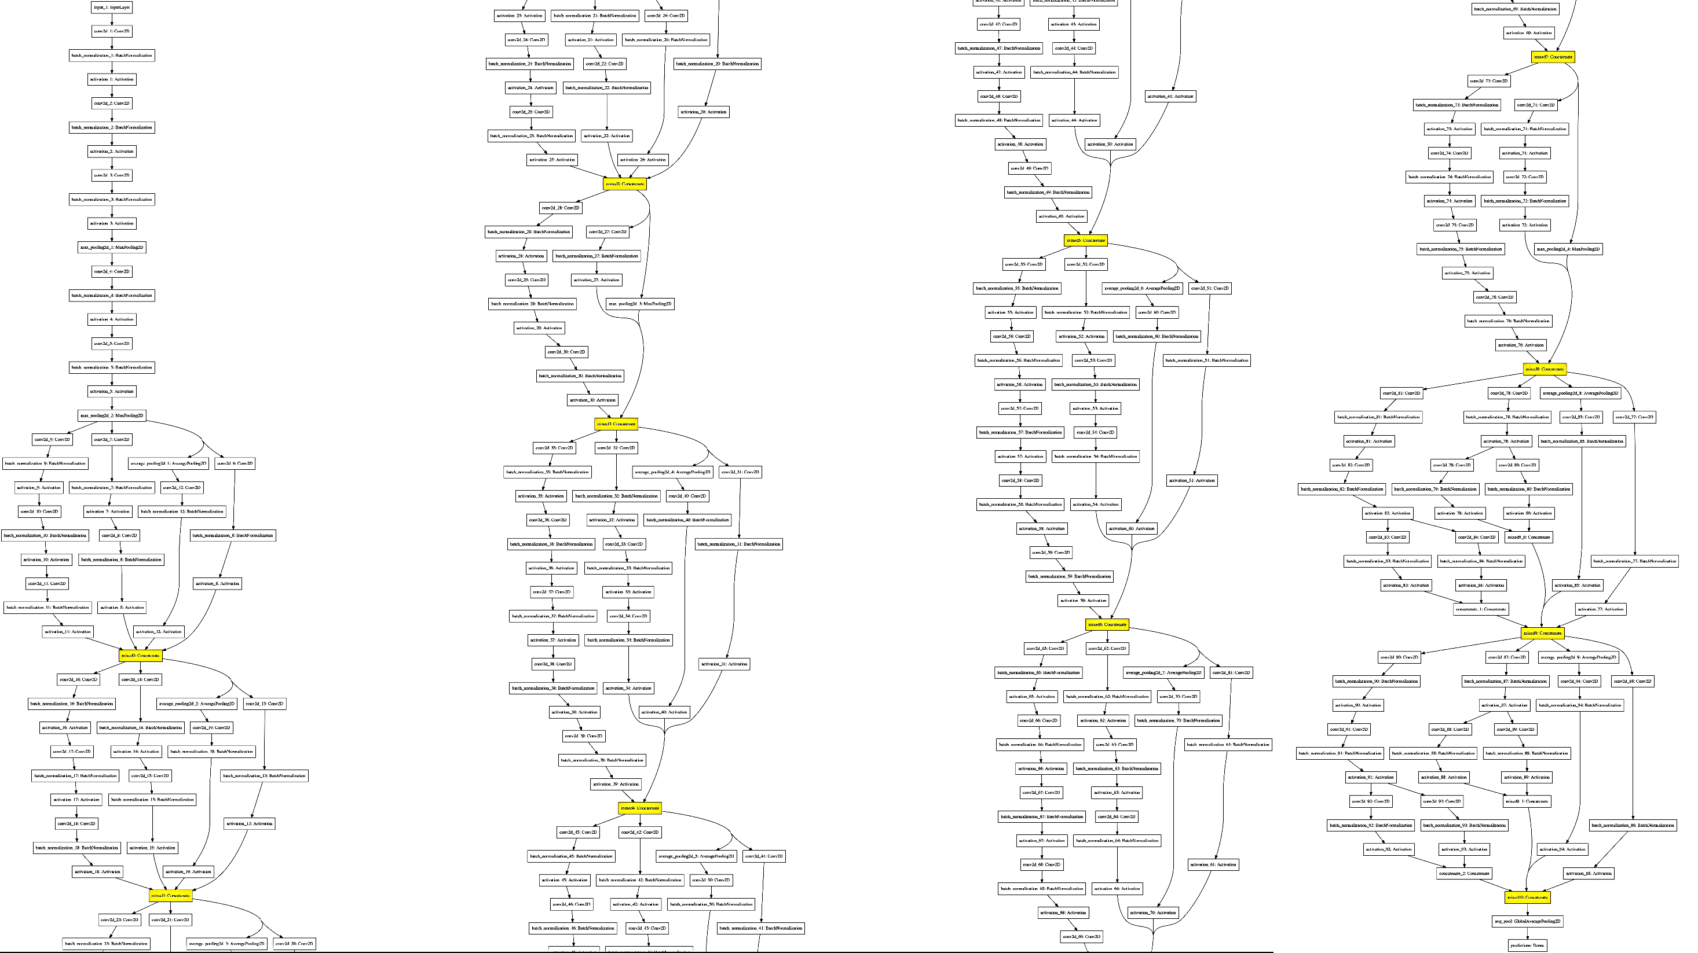

Slide 20
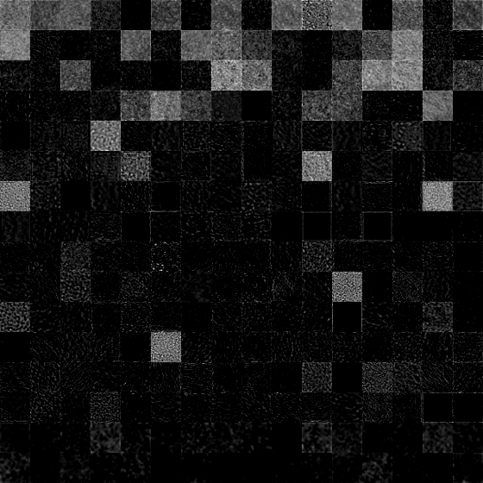
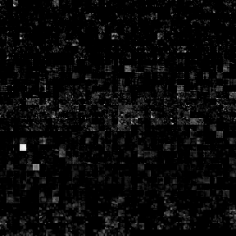
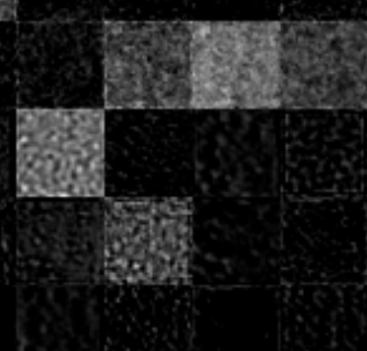
VISUALIZING ACTIVATIONS
MIXED 8 [8x8x1280]
INPUT [299x299x3]
MIXED 0 [35x35x256]

Slide 21
AlexNet
Input: 227x227x3
Images are
cropped to this
dimension

Slide 22
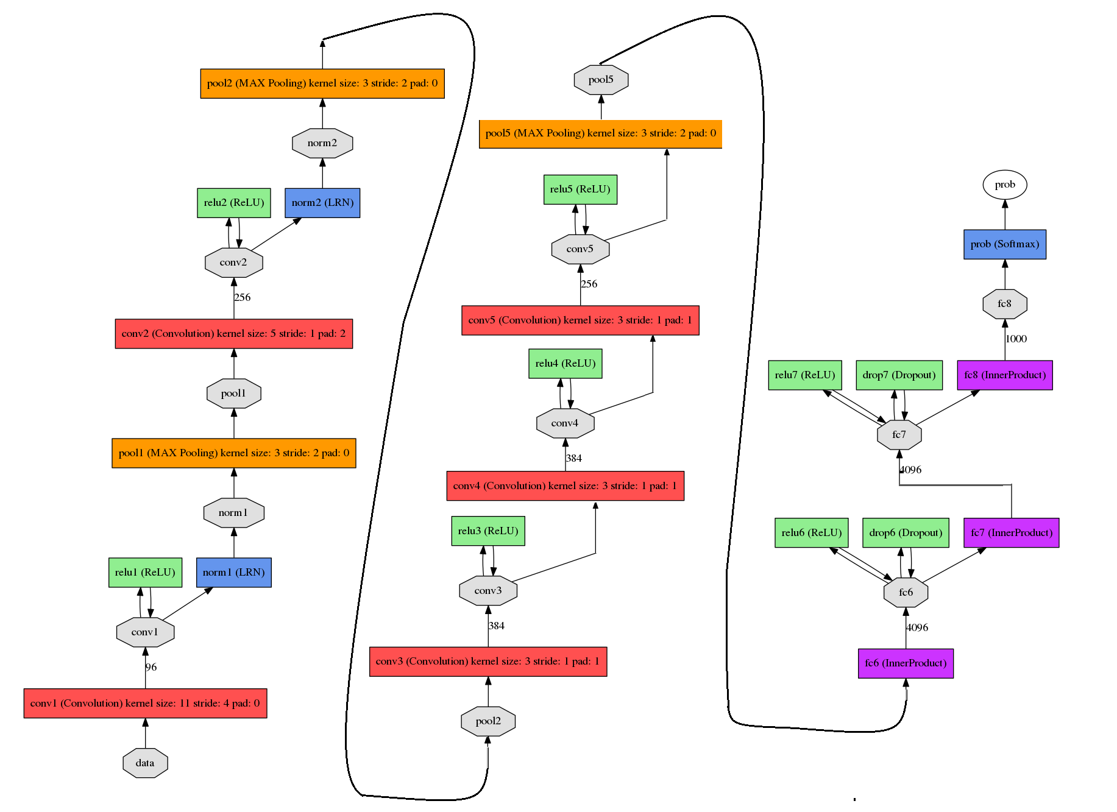
AlexNet

Slide 23
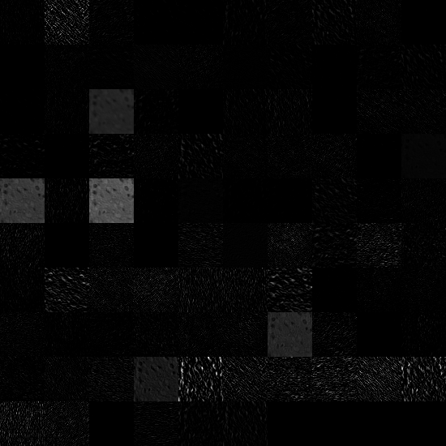
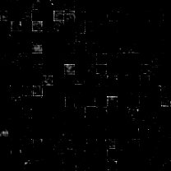
VISUALIZING ACTIVATIONS
CONV5 [13x13x256]
INPUT [227x227x3]
CONV1 [55x55x96]

Slide 24
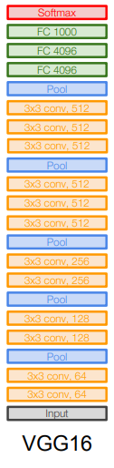
VGG-16
Input:
224x224x3
Images must be
cropped to this
dimension

Slide 25
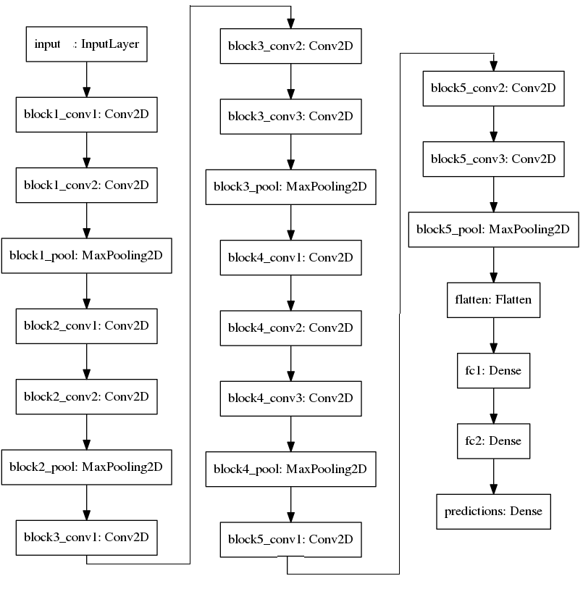
VGG-16

Slide 26
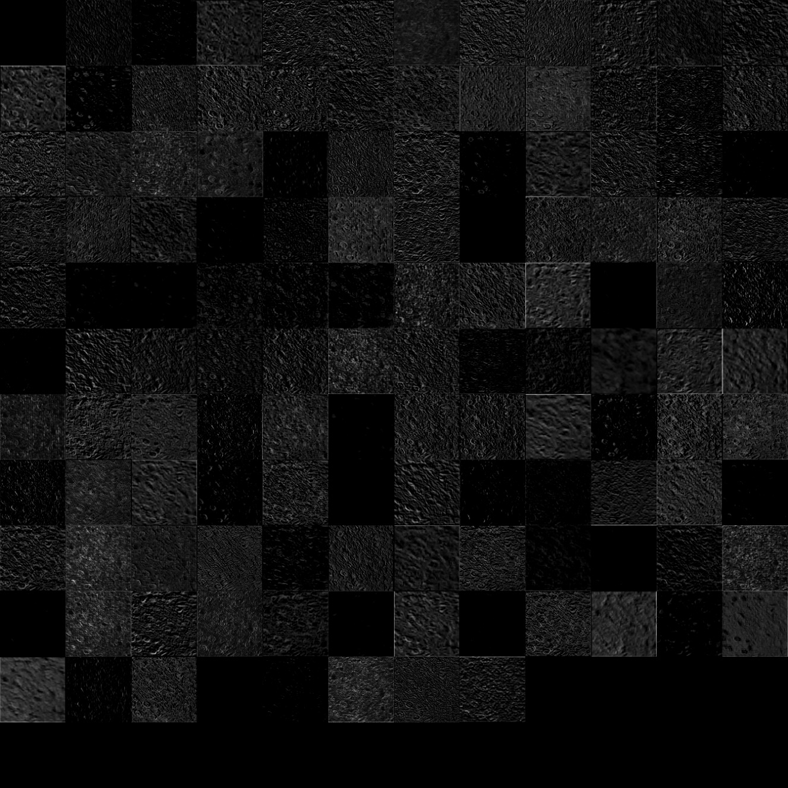

VISUALIZING ACTIVATIONS
INPUT [224x224x3]
BLOCK4-CONV3 [28x28x512]
BLOCK2-CONV1 [112x112x128]

Slide 27
WORKFLOW
RGB
DataSet
FEATURES EXTRACTION:
PRE-TRAINED CNN
DIMENSIONALITY REDUCTION:
t-SNE, PCA, LDA, NNMF
IMAGES
PRE-PROCESSING:
Additional DATASETS CREATION
CROP of the images
CLASSIFICATION:
SVM, Random Forest, Naive Bayes, k-NN
FEATURES EXTRACTION: BAG OF FEATURES
COMPARING RESULTS
CLASSIFICATION: SVM

Slide 28
DIMENSIONALITY REDUCTION
MACHINE LEARNING LIBRARY:
Scikit-learn
Using DimensionalityReduction_GUI.py.

Slide 29
DEMO DimensionalityReduction_GUI.py

Slide 30
t-SNE (t-distributed stochastic neighbor embedding)
from sklearn.preprocessing import StandardScaler
from sklearn.manifold import TSNE
Standardize features → removing the mean + scaling to unit variance
Dimensionality pre-reduction to 50 components → PCA
Concatenate Training and Test Set
Fit and transform the concatenated matrix using t-SNE
Separate the reduced Training and Test Set

Slide 31
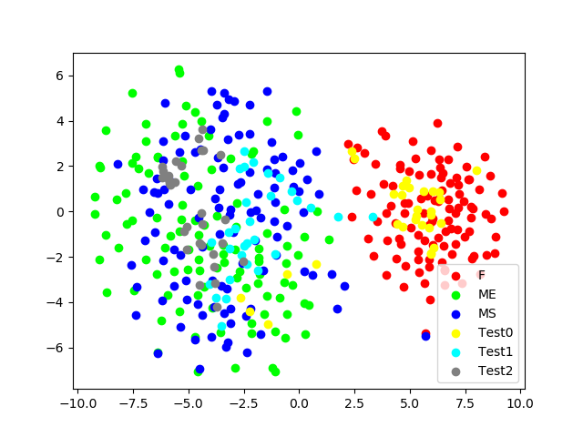
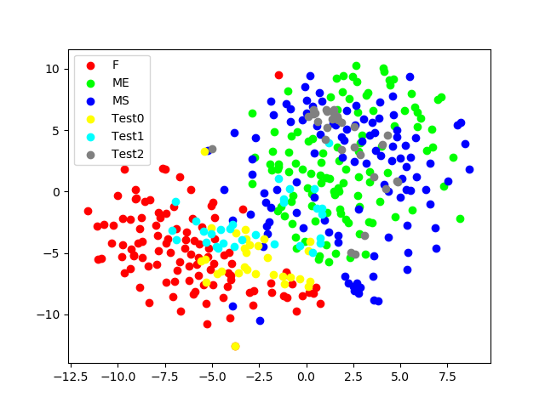
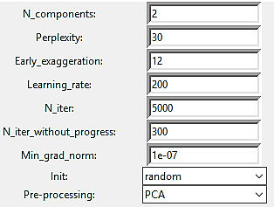
EXAMPLES OF REDUCED FEATURES VISUALIZATION: t-SNE
Parameters
Hematoxylin DataSet,
VGG-16 block3-conv2,
t-SNE 2 components
GrayScale DataSet, Inception-v3 mixed0,
t-SNE 2 components

Slide 32
PCA (Principal component analysis)
from sklearn.preprocessing import StandardScaler
from sklearn.decomposition import PCA
Standardize features → removing the mean + scaling to unit variance
Fit PCA on the Training Set
Transform Training Set and Test Set.

Slide 33
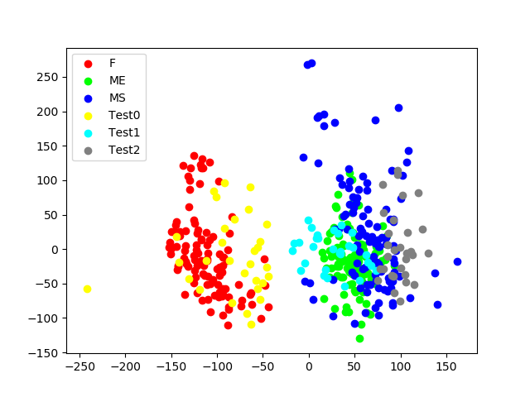
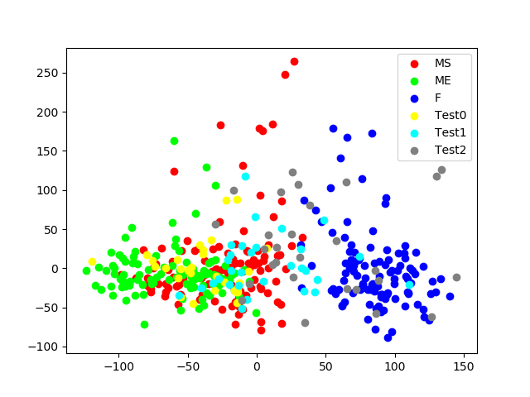
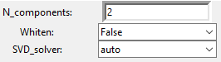
EXAMPLES OF REDUCED FEATURES VISUALIZATION: PCA
RGB DataSet,
Inception-v3 mixed0,
PCA 2 components
Reinhard DataSet,
AlexNet Conv2,
PCA 2 components
Parameters

Slide 34
LDA (Linear Discriminant Analysis)
from sklearn.preprocessing import StandardScaler
from sklearn.discriminant_analysis import LinearDiscriminantAnalysis
Standardize features → removing the mean + scaling to unit variance
Fit PCA on the Training Set
Transform Training Set and Test Set.

Slide 35
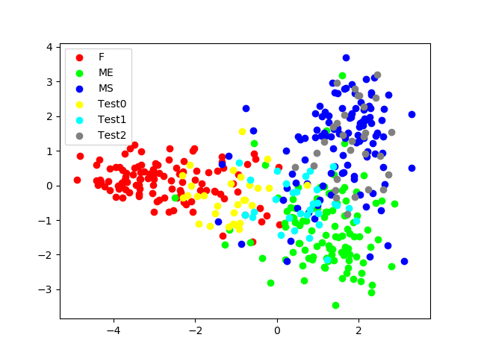
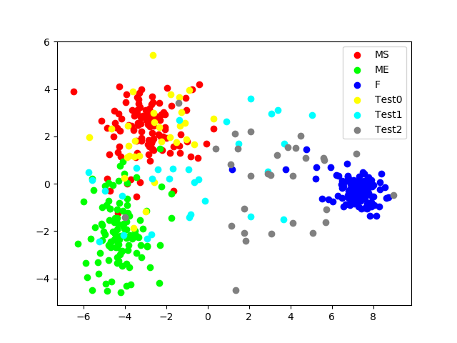
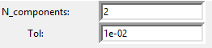
EXAMPLES OF REDUCED FEATURES VISUALIZATION: LDA
RGB DataSet,
Inception-v3 mixed10,
LDA 2 components
Parameters
Reinhard DataSet, GoogLeNet Pool5/7x7_s1,
LDA 2 components

Slide 36
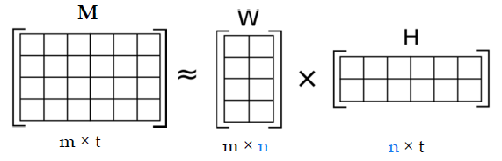
NON-NEGATIVE MATRIX FACTORIZATION
from sklearn.decomposition import NMF
Fit NNMF on the Training Set
Transform Training Set and Test Set.

Slide 37
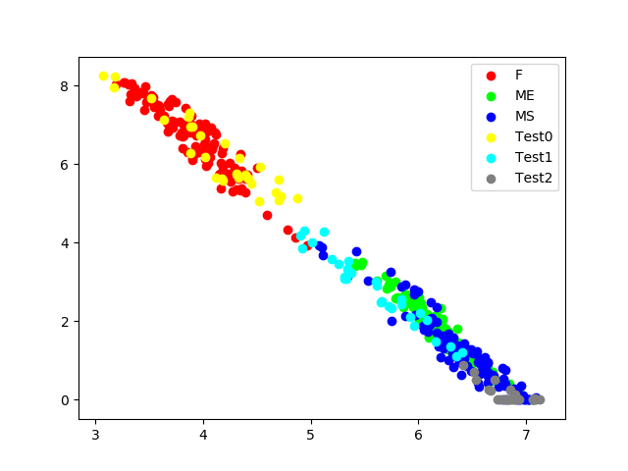
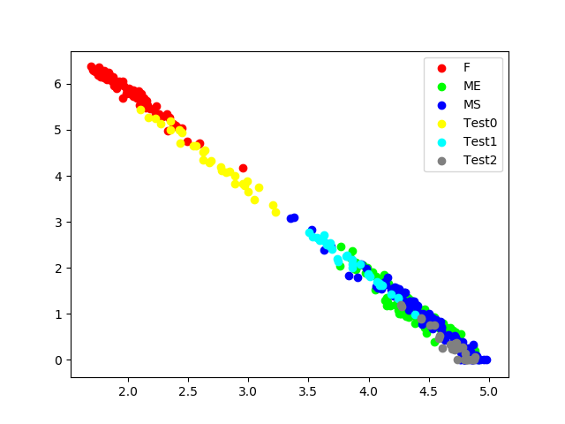
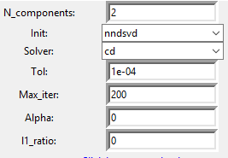
EXAMPLES OF REDUCED FEATURES VISUALIZATION: NNMF
Parameters
RGB DataSet,
Inception-v3 mixed0,
NNMF 2 components
RGB DataSet,
Inception-v3 mixed2,
NNMF 2 components

Slide 38
WORKFLOW
RGB
DataSet
FEATURES EXTRACTION:
PRE-TRAINED CNN
DIMENSIONALITY REDUCTION:
t-SNE, PCA, LDA, NNMF
IMAGES
PRE-PROCESSING:
Additional DATASETS CREATION
CROP of the images
CLASSIFICATION:
SVM, Random Forest, Naive Bayes, k-NN
FEATURES EXTRACTION: BAG OF FEATURES
COMPARING RESULTS
CLASSIFICATION: SVM

Slide 39
CLASSIFICATION
MACHINE LEARNING LIBRARY:
Scikit-learn
Using Classification_GUI.py.

Slide 40
DEMO Classification_GUI.py

Slide 41
Multi-class SVM (Support Vector Machine)
from sklearn.svm import SVC
Decision function → One vs Rest
Kernel: RBF
Tuning on C and Gamma:
10-fold Cross-validation on Training Set
Classify Test Set
C = [0.001, 0.01, 0.1, 1, 10 , 100, 1000]
Gamma = [0.001, 0.01, 0.1, 1]

Slide 42
Random Forest
from sklearn.ensemble import RandomForestClassifier
Criterion→ Gini
Tuning on number
of trees in the forest:
10-fold Cross-validation on Training Set
Classify Test Set
N_estimators = [10, 20, 30]

Slide 43
Gaussian Naive Bayes
from sklearn.naive_bayes import GaussianNB
10-fold Cross-validation on Training Set
Classify Test Set

Slide 44
K-NN
from sklearn.neighbors import KNeighborsClassifier
Tuning on Number
of neighbors:
10-fold Cross-validation on Training Set
Classify Test Set
N_neighbors = [1, ..., 9]

Slide 45
Best accuracies obtained
RANDOM FOREST
MULTI-CLASS SVM
GAUSSIAN NAIVE BAYES
K-NN
95.6 %
91.1 %
95.6 %
96.7 %

Slide 46
WORKFLOW
RGB
DataSet
FEATURES EXTRACTION:
PRE-TRAINED CNN
DIMENSIONALITY REDUCTION:
t-SNE, PCA, LDA, NNMF
IMAGES
PRE-PROCESSING:
Additional DATASETS CREATION
CROP of the images
CLASSIFICATION:
SVM, Random Forest, Naive Bayes, k-NN
FEATURES EXTRACTION: BAG OF FEATURES
COMPARING RESULTS
CLASSIFICATION: SVM

Slide 47
FEATURES EXTRACTION using Bag Of Features
Parameters:
Vocabulary Sizes selected → 200, 2000
Strongest Features → 0.8
Using BagOfFeatures.m.

Slide 48
Multi-class SVM (Support Vector Machine)
Decision function → One vs Rest
Kernel: RBF
Tuning on C and Gamma:
10-fold Cross-validation on Training Set
Classify Test Set
C = [0.001, 0.01, 0.1, 1, 10, 100, 1000]
Gamma = [0.001, 0.01, 0.1, 1]

Slide 49
DEMO BagOfFeatures.m

Slide 50
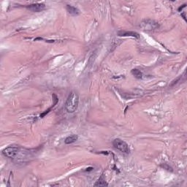
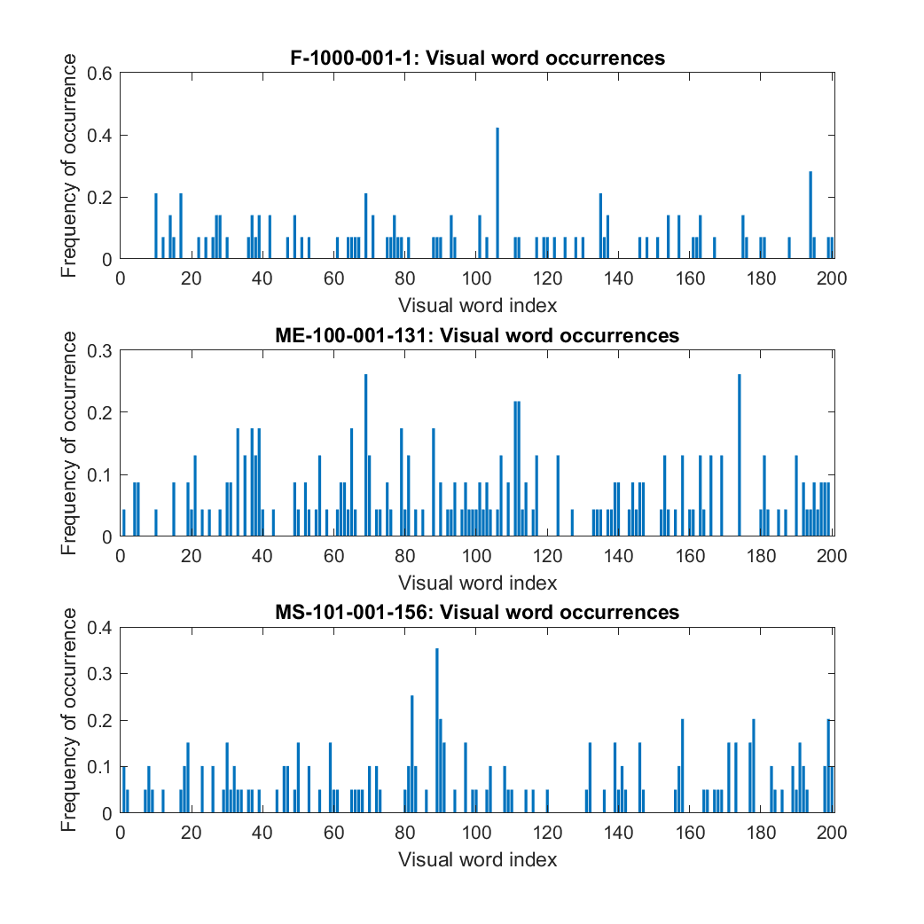
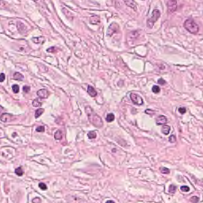
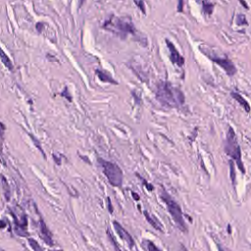
Examples of features vectors histograms

Slide 51
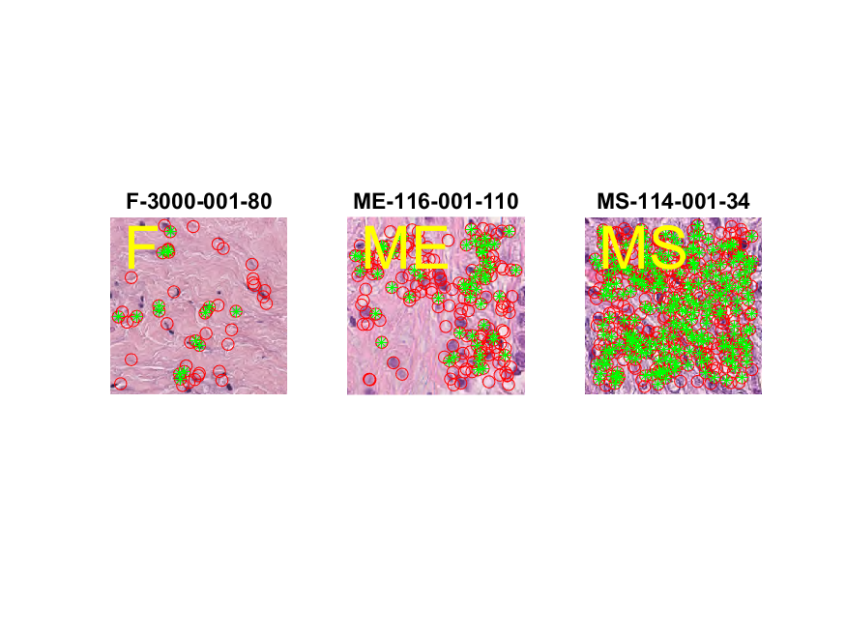
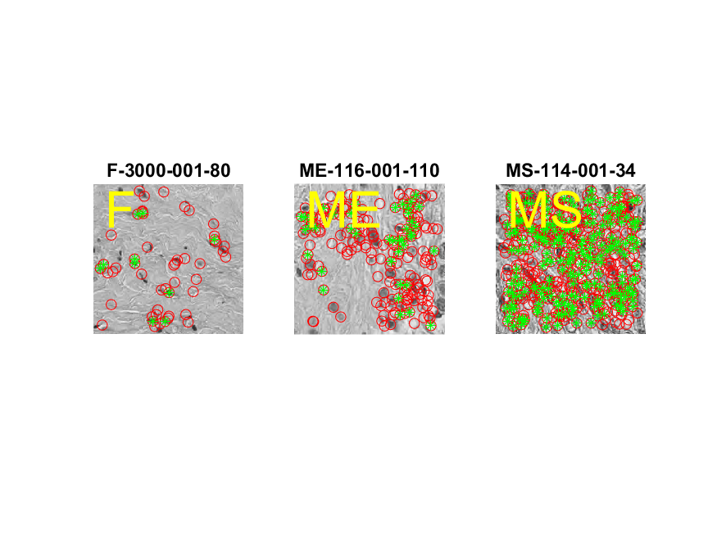
Examples of words on images

Slide 52
Results of classification using Multi-class SVM
VocabularySize | DataSet | Cross-Validation 10-fold | Accuracy_on Test Set | pccF | pccME | pccMS
2000 | RGB | 0.864 | 0.722 | 0.933 | 0.367 | 0.867
200 | Hematoxylin | 0.848 | 0.656 | 0.8 | 0.3 | 0.867
200 | RGB | 0.818 | 0.633 | 0.867 | 0.2 | 0.833
2000 | GrayScale | 0.858 | 0.633 | 0.967 | 0.1 | 0.833
200 | GrayScale | 0.824 | 0.6 | 0.867 | 0.133 | 0.8
2000 | Hematoxylin | 0.858 | 0.567 | 0.833 | 0.167 | 0.7
200 | ReinhardNormalization | 0.855 | 0.556 | 0.533 | 0.367 | 0.767
2000 | ReinhardNormalization | 0.843 | 0.533 | 0.833 | 0.167 | 0.6

Slide 53
Comparison between best results
CNN → Dimensionality Reduction → Classification → 97.6 %
Bag of Features → Classification → 72.2 %

